Slide 1
Glen Urquhart Community Council Discussion on Springfield Planning Applications for Mixed Use and Housing Developments – Drum Farm
View from A82 / Druimlon
Notes:
Community Council have prepared a presentation on the 2 Springfield Applications, this presentation is based on feedback received and comments people have made to the Highland Council Planning page. Based upon what we hear tonight and taking account of views expressed to members of the Community Council we will then finalise our response to the Planning Applications.
Largest single housing / commercial application to come to our area 94 houses plus office / retail. If you take the relative population of Drum / Inverness it would be the equivalent of over 4,000 houses in the town. It is also viewed not just at road level from the village centre, it is viewed from above as you approach from Inverness or look down from key view points such as Craigmonie. So it worth trying to get it right.
When we last checked the mixed use application had received 1 objection by a member of the public and 1 Consultee Objection – Highland Council Transport Planning, not all Consultees have responded
The housing had received 12 public objections plus consultee objection from Highland Council Transport Planning, SEPA (but would accept a mitigating Condition if permission is given), not all Consultees have responded
Although the initial deadline for comments has passed Highland Council have confirmed they will continue to accept comments from the public and although they be regarded as “non-timeous” any material planning matters will be taken into account.
Finally our Councillors who are here tonight cannot express a view on whether they support or object to the applications, they will keep me right if I say something wrong and will help answer any questions that the CC cannot .
The picture above is the view Springfield have shown of the development as viewed from Druimlon

Slide 2
Planning Applications to be discussed
19/02761/FUL - Erection of 94 (including 25 affordable) homes and associated works.
19/02762/FUL - Formation of mixed use village core of nursery, office space and retail (food and non-food).
Situated on land At Drum Farm (South Of Fire Station) Drumnadrochit
(Largest housing / mixed use application for Glen Urquhart Community Council)
2 Applications for the land identified as DR5 in the Inner Moray Firth Local Development Plan 2015 (IMFLDP)
Proposed delivery in 4 phases with phase 2 being the Mixed Use Development
Notes:
Initial application for 94 houses was rejected primarily due to access from Kilmore Rd and as Springfield did not have sufficient control over the mixed use development.
Springfield have now applied again for 94 houses , but all vehicle access from A82 and they have applied for the mixed use site also.
We know some people were unaware of the second drop in session Springfield held on the housing application. Under current planning law they could have resubmitted the housing application without the 2nd meeting, but if they wanted to issue a new single application it would have restarted the process and delayed them 3 months. Planning law is changing to address this anomaly.
When talking tonight if I refer to the Local Plan it is the Inner Moray Firth Development Plan 2015 I am referring to.

Slide 3
Community Council Planning Decision Diagram
Process
Delegated Powers
Highland Council Committee
Application
Complies with Planning policies including Local Plan?
Does it have Neighbour and/or Community Support?
Mitigations
Good Points
Improvements
Respond to Application.
Support / Comment / Object
Scottish Government Reporter
Notes:
When the Community Council receive a significant planning application this is a summary of the process we go through (Application Column), we are aware that the person who finally decides on the application may not know Drum well (see Process) so its important to highlight what are key issues for us (Mitigations Column).
So tonight we will start by looking at the question – Does it comply with the Local Plan, then we will look at more detailed aspects of each application, I will take comments at key stages as we go along and there will be time for comments / questions at the end.

Slide 4
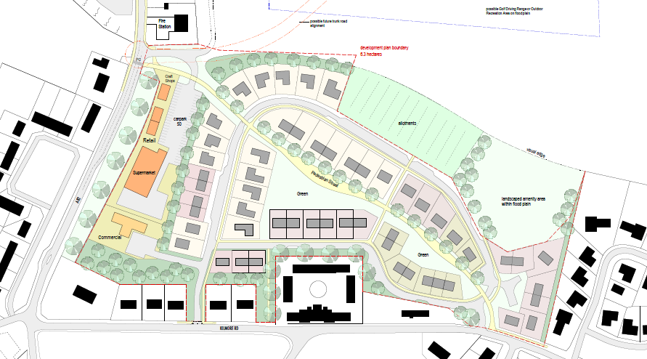
Inner Moray Firth Local Development Plan 2015
Background – the initial plan when IMFLDP was discussed
Notes:
During the consultation period for the 2015 Plan the community knew that Loch Ness Homes had submitted a plan for 75 houses plus new shop etc. and that was being considered by the Scottish Government Reporter, at the same time we had the above plan for Drum Farm (Describe 55 houses, green corridors, access issue), this was broadly supported by the community as being a sympathetic use of the land and the CC supported it being included in the Local Plan.
So what does the Local Plan say about Drum and about Drum Farm in particular

Slide 5
Inner Moray Firth Local Development Plan 2015
What it says about Drumnadrochit
4.106 Drumnadrochit has more facilities than would be expected for a village of its population
and closeness to the Highland capital. This is due to its wider glen catchment, its
picturesque setting along the Great Glen and A82 and the enthusiasm of its community
leaders. The Plan seeks to retain and expand upon these facilities hand in hand with an increase in the local resident population. The open fields that separate Drumnadrochit’s settlements are important to its character. This separation should be maintained where possible and safeguarded by green corridors accessible to wildlife and the wider community. Other constraints include woodland that should be protected and the flood risk areas associated with the Coiltie and Enrick rivers.
4.107 Application of these principles has led us to allocate development land at the heart of
the community, where longer road improvements are not required and where more
people can walk or cycle to facilities. Developer requirements are required to ensure
the village is not “swamped” by a surge in building and to ensure the character of the village is maintained and even enhanced by the quality of the new buildings, their layout and their good connectivity.

Slide 6
Inner Moray Firth Local Development Plan 2015
What it says about DR5
Site: DR5 Drum Farm Area (ha): 5.7 Uses: 55 homes, Business, Retail, Community.
Requirements: Developer to prepare masterplan / development brief and address:
Phasing of a maximum of 10 housing units per annum;
Any application must include a non-housing element which must be provided within an initial phase of development;
High quality of architectural design respecting the site’s prominent tourist route location; landscaped set back from A82 including stone dyke feature and remote footpath / cycle way;
Publicly accessible green corridor retention to retain and frame public vistas and to maintain a degree of visual separation between settlements;
Connection to wider village path network;
Notes:
One of the important requirements in the Local Plan and where Springfield seem to be having a major departure is number of houses, so lets look at that in more detail

Slide 7
Background – the number of houses allocated in the Plan vs applications received
Area | Allocation | Planning Applied for | Comments
DR1 | 4 | 0 | Flooding issues
DR2 | 5 | 0 | No current plans
DR3 | 2 | 4 | Awaiting decision
DR5 | 55 | 94 | THIS APPLICATION
DR6 | 75 | 99 | Phase 4 & 5 awaiting decision, site governed by Scot Gov appeal
DR9 | 6 | 4 | Old medical centre
Infill sites |  | 10 | Excludes PIP / old shop site
Total | 147 | 211
Notes:
Explanation of where each area is.
In calculating the Drum quota of 147 the requirement was that the Local Plan takes a 10 – 20 year view on development needs for the wider Inverness area, they then allocate that to the town and surrounding villages, in our case that came to 117 houses, they then add a 25% factor to give an element of elective choice – hence the allocation of 147 houses to Drum to cover up to a period of at least 2025 and maybe as far as 2035.
What does the plan say about the number of houses allocated to each site – it is Clause 2.12 that Springfield use to justify the increase from 55 houses to 94 houses and still “compliant with Local Plan”

Slide 8
Inner Moray Firth Local Development Plan 2015
What it says about number of houses allocated per site.
Site Capacities
2.12
Indicative housing capacities for each site are shown within the tables in Section 4 of this Plan. Planning applications are expected to be generally consistent with the indicative capacities specified. However a different capacity than that specified may be acceptable subject to detailed design that demonstrates efficient use of land and a satisfactory site layout.
2.13
These capacities were calculated to promote the efficient use of land and have taken account of the general site conditions and the relative accessibility of the site. Where available any planning history of the site was also taken into consideration.
Notes:
Read 2.12 & 2.13, if HC took account then they couldn’t possibly by out by nearly 100%, a 5% to 10% variation may be understandable in special circumstances

Slide 9
Summary – the number of houses allocated in the Plan
The IMFLDP took a 10 – 20 year view, in the words of Highland Council they provided a generous (25%) allocation of houses and they carefully assessed the capacity for each site.
The total allocation for Drumnadrochit village was 147, assuming the other applications are approved then with no development at Drum Farm we would have 117 houses, and that is the target number before the 25% factor was added.
There is therefore an argument that this development is not needed. If permission is given for 55 houses as per the Plan then it will be important that the next Development Plan does not allocate any large housing sites for general development as we will have exceeded our quota.
There is certainly no case to support an allocation of 94 houses as that would equate to an over development by 43% and overdevelopment of DR5. Based on population it would be the equivalent of 4,100 houses in Inverness
Highland Council carefully considered the density of housing when they allocated 55 houses, so again no reason to invoke Clause 2.12 for a higher density.
Notes:
To summarise on the number of houses issue – and to answer the question of whether the local plan supports 94 houses, looking both at Drum Farm and even taking account of the wider Drum Developments

Slide 10
IMFLDP Compliance Conclusion
,
The community engaged very carefully on the IMFLDP 2015
Site DR5 and Drumnadrochit as a whole have clear requirements
We have reviewed the grounds for adjustment on the number of houses
We believe it is important for future of Drumnadrochit and for public confidence in the Development Plan process that site DR5 delivers no more than the stipulated number of houses (55) along with a high quality mixed use development.
We propose to OBJECT on the grounds that the application is non compliant with IMFLDP 2015
Notes:
Read slide – ANY COMMENTS / QUESTIONS AT THIS STAGE
Now to look at each application in more detail.

Slide 11
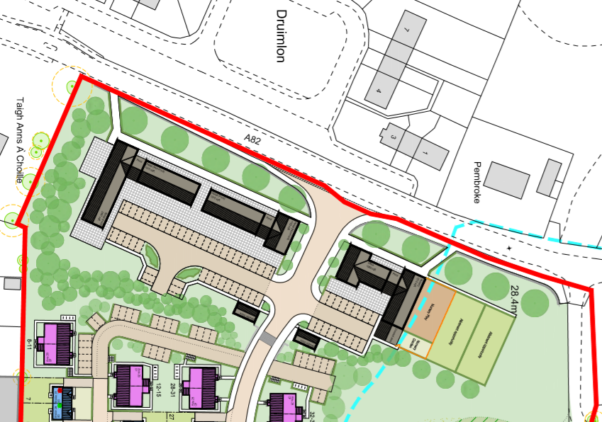
Mixed Use Development Layout
,
Notes:
Brief description café, then non-food retail, food retail, non-food retail
Office, nursery, play area for nursery, allotments
Bike storage, bin storage, bin storage, bike storage
Stacking lane
Flood plain squeezing everything to the south
Footpath / cycle way does not go to crossing / Fire Station

Slide 12
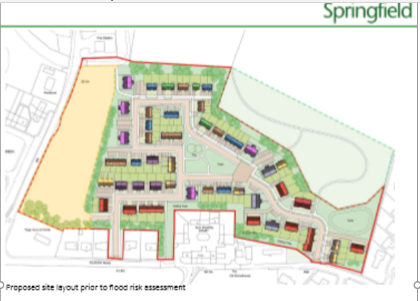
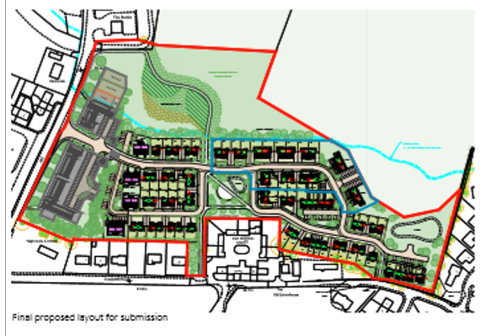
Mixed Use Development Detailed Comments
,
Site size is restricted by Floodplain and housing development
Notes:
One of our main concerns is the impact of the site being squeezed to the south and also by the houses, is there space to fit everything in? especially when you don’t know end users

Slide 13
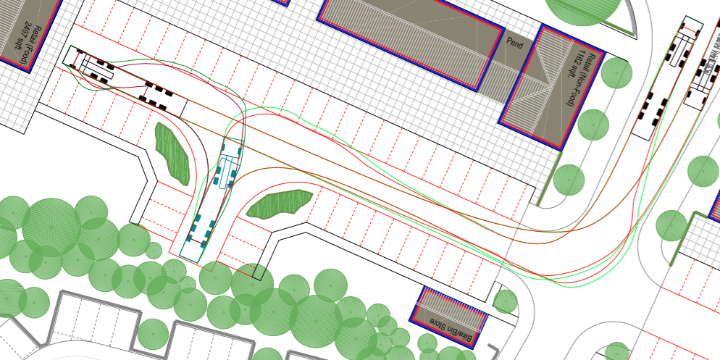
Mixed Use Development Detailed Comments
,
Inadequate separation of delivery vehicles / general public
Notes:
Traffic and parking – only 61 parking spaces , HC estimate at least 69 needed

Slide 14
Mixed Use Development Detailed Comments
,
Grounds for OBJECTION.
The applicant has not demonstrated that the proposed depth of site is sufficient to accommodate for the realignment of the A82, a stone dyke and landscaping to mirror the Druimlon wall and avenue of trees, a 3m wide footpath and cycleway, the commercial development including parking and servicing requirements and the landscaping between the commercial development and housing.
We are concerned that there is no segregation for vehicles serving the commercial areas and users
There is insufficient parking provided with Highland Council estimating a requirement for 69 spaces and only 61 spaces provided. Parking may also be needed for delivery vehicles
The 3m cycleway/footpath does not extend as far as the proposed A82 crossing point. We support Highland Council that this should be a Toucan Crossing point. In addition this needs to be delivered at the very start.
There are no bus stops provided on A82
The design for the mixed-use section is very speculative at this stage and the applicant is providing quite a restricted space in terms of size and parking. This may lead to issues further down the line when the proposed users are known for example shops can need twice as much parking space as offices. Without sufficient detail at planning stage or flexibility to accommodate different users types could result in parts of the site becoming difficult to deliver.
Notes:
So although in a number of ways we welcome the mixed use element of the development, when closely examined we feel we need to object at this stage - read slide
In addition we have further comments

Slide 15
Mixed Use Development Detailed Comments
,
Additional Comments.
The 3m cycleway/footpath needs to extend at the north end to the Fire Station. The drop kerbs at the Fire Station need to be realigned as they currently lead you into the path of the A82.
The A82 entrance will need an island mid-way for pedestrians as it is a wide opening
Realignment of the A82 to accommodate a stacking lane
The Drumnadrochit Flood Scheme will be delivered within 2 years and this will enable the full width of land to the Fire Station to be developed. The design for the whole DR5 area should be revised and adjusted to deliver what the Local Plan says – 55 houses and a mixed use area along the A82, it can be phased to take account of the new Flood Scheme. It should then be resubmitted as a single application.
The developer should work with the local Chamber of Commerce to ensure the retail units are delivering quality services for the Glen and we do not end up with a street of cafes and gift shops. We would encourage units such as butchers, bakery, grocer, hairdresser, optician, arts and crafts workshop etc.
Conditions to ensure the architecture and building height reflects and ties in with the housing and shops around Drum Green
The finished ground level should be similar to the existing ground level to prevent issues with ground water intrusion.
Ensure the boundary dyke is similar in construction and height to the Druimlon wall.
The landscaping along the A82 to reflect the Druimlon trees
A clear view of Craig Nay to be maintained for people walking beside A82
Notes:
QUESTIONS AND COMMENTS
Onto the housing section

Slide 16
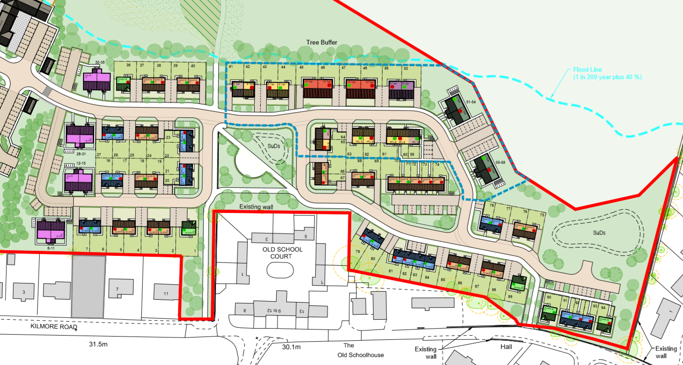
Housing Development Layout
,
Notes:
94 houses, nearly all 2 storey, no tree buffer against Kilmore Rd houses, access onto A82, cycle loop around school

Slide 17
Housing Development Detailed Comments
,
Rate of Development
Rate of development. The applicant states that “The prescribed phasing cannot be complied with as it will compromise the satisfactory delivery of the overall development” and based on previous application it would appear that they are proposing a rate of build of approx 30 houses per year.
We have explained above why the rate of build specified in the Development Plan is appropriate to our community.
We recognise that the initial development rate for affordable houses may need to be increased to cover the infrastructure costs and would support the affordable housing development being delivered in year one.
We propose that between them Loch Ness Homes (LNH) site and Springfield build 20 houses / year
The above is in line with LNH requirements

Slide 18
Housing Development Detailed Comments
,
Mixed use Development being a separate application
We are concerned that the commercial section (phase 2) is covered by a separate application and this is an important aspect of the IMFDP 2015.
As noted in the Report of Handling for the previous planning application that unless the non-housing section is within the application boundary and within the applicants control then it is very difficult to have a legally enforceable condition that secures the delivery of the non-housing development. We note the various concerns Highland Council had regarding the delivery, access and drainage from the commercial section. We suggest that the current application is refused and the applicant submits an application which covers the whole of area DR5 and is fully compliant with IMFDP 2015.
Notes:
Our preference was for 1 application covering the whole development, I explained in the introduction why that didn’t happen, we are just raising our concern that nothing drops between the cracks.

Slide 19
Housing Development Detailed Comments
,
Infrastructure
Whilst Highland Council and the various utility companies will undertake their own assessment we would highlight the following known issues:-
Drainage - there is a long standing problem with drainage from Drum Bridge to Druimlon, in part due to the condition of the sewer running through the land within this application. It is important that drainage improvements fully resolve the capacity requirements. In addition surface water can run on the east side of the A82 from Blairbeg (the bus stop beside the old shop) all the way to opposite 1 Druimlon and again this needs to be resolved as much of that water finds its way into the fields covered by this development.
Childcare - With the increase in population and increased hours of free childcare provision the current childcare centre is needing to find new larger premises and the developer is encouraged to engage in resolving that issue.
Primary Education - The Primary school is at capacity and new classrooms will be required before this development is fully progressed, a move to the location currently occupied by childcare may help.
Notes:
Questions / Comments on infrastructure

Slide 20
Housing Development Detailed Comments
,
The Highland Council policy requires that 25% of the houses should be affordable. Whilst 26% of the proposed 94 properties are described as “affordable” we note that the applicant is proposing eight 1 bed flats and o as a proportion of beds they are only offering just over a 20% allocation.
The Highland Wide Development Plan states
We would recommend that there are no 1 bed flats and increase the number of 3 bed units from two to eight. This would give seventeen 2 bed units and eight 3 bed units which would be closer to meeting the spirit of the Highland Council policy and local need as well as meeting the requirement for the housing to be indistinguishable.
.
Notes:
This slide is about the affordable housing element, read slide in summary, mention Margaret having drop in sessions

Slide 21
Housing Development Detailed Comments
,
Design & Layout
The development will be highly visible and is set in the heart of Drumnadrochit. The IMFLDP 2015 requires that the design and layout meets the highest possible standards and is compatible with other housing in the area.
The area we consider appropriate and that it is compatible with is the original development of Kilmore Road, Enrick Crescent and Coiltie Crescent. These areas are characterised by a variety of house styles, often incorporating stone features and muted colours. The Kilmore area is characterised by a mix of houses including bungalows, 1.5 storey and 1.75 storey high but not 2 storey houses.
The new development should reflect this design and mix.
Notes:
Read questions ?

Slide 22
Housing Development Detailed Comments
,
Road Safety
We welcome the fact that all vehicle access will be from the A82 and not Kilmore Rd.
It is assumed that Transport Scotland will require a stacking lane for traffic coming from Fort Augustus. However the development will result in a significant increase in pedestrians and cyclists wishing to cross the A82 and in particular school children.
We would ask therefore that a requirement for a Toucan crossing close to Kilmore Road is included in any planning conditions and that this is in place before any houses are occupied.
We understand that was included in the original planning application and that would be welcomed

Slide 23
Housing Development Detailed Comments
,
Archaeology.
We note that a number of finds were made during the recent works by Loch Ness Homes. It is likely that similar finds of local rather than national significance will be made at this site. We ask that the Developer works with the local community to incorporate finds within a heritage trail and a sum of money should be identified for this project, say £15,000
Notes:
Read / comments on last 2 slides

Slide 24
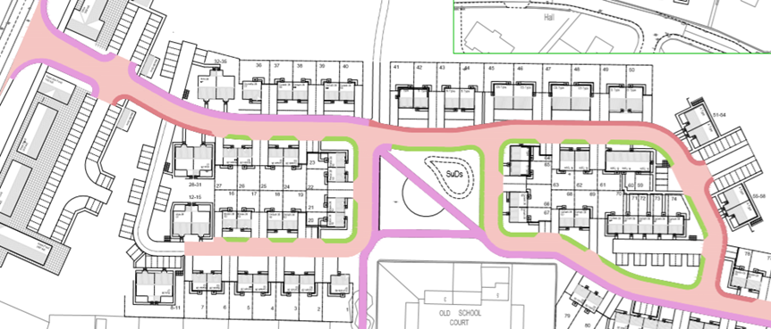
Housing Development Detailed Comments
,
Footpaths – see below where
3m wide cycle / footpath (purple) , 2 m wide footpaths (brownish) and grass verges (green) – see extract below
Highland Council Transport Planning have made comment and we would add that we would expect all houses to have an adjacent footpath and not have to cross the road on leaving home
Notes:
recent drawing added by Springfield on 10th August Grass verges to houses

Slide 25
Housing Development Detailed Comments
,
Additional Considerations
It is expected that the area currently occupied by Cobbs Bakery will become available for development in the next few years. This is in close proximity to our local Care Centre and may well be developed as homes that would be supported by the Care Centre. From a safety view point and to create a cohesive development it would be best that the Cobbs site is accessed from the Drum Farm development area. We would request that houses 79 & 80 are removed and a burden-free site access created.
The location of the site compound / storage areas and phasing of road / path construction must ensure that from when the first residents move into the scheme they have safe vehicle, pedestrian and cycle access to the A82.
It is likely that significant quantities of topsoil will be excavated and to prevent an increase in flood risk these should not be stored or landscaped in the area identified as being at risk of flooding. There may be a community project that could use a significant quantity of topsoil and we would request a condition that excess topsoil should be offered to a community project sited no more than 1 mile from the site.
There is a risk of flooding from ground water and we would ask that the site is developed at or close to existing ground levels.
There should also be a community liaison group set up including our local Councillors, Community Council, Glen Urquhart Rural Community Association and other groups as appropriate
Notes:
Additional comments

Slide 26
Housing Development Detailed Comments
,
In conclusion this application fails to meet IMFLDP requirements on a whole range of measures and needs to be rejected in its current form. We feel that the site is better suited to a more varied development, perhaps including self-build plots. The original plan was for a large development but it was well considered and included features that would have helped enhance the village, we strongly recommend that any new application for this site adheres closely to that philosophy and hence delivers what is required by the IMFLDP 2015.
Notes:
Conclusion

Slide 27
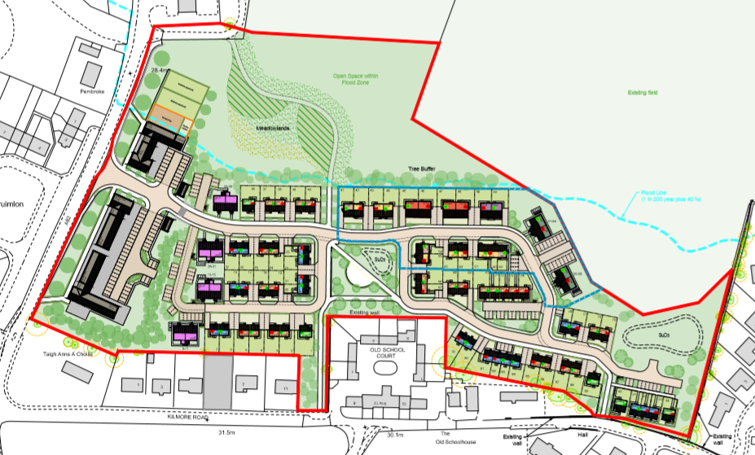
Questions / Comments
,

